Slide 1
SÜLEYMAN DEMİREL UNIVERSITY
ISPARTA/ TÜRKİYE
A University that inspires…

Slide 2
Süleyman Demirel University, a public university based in Isparta, Turkey, was established in 1992. It has completed its institutionalization process in the last decade.
SDU is considered as one of the most esteemed institutions of higher education in Turkey together with the academic units, teaching staff, number of students, physical capacity and scientific researches; it offers a wide range of social, cultural and sports activities and consists of 19 faculties including undergraduate degree programmes, 5 higher schools, 21 vocational colleges that provide with associate degree education, besides 6 institutes providing post-graduate education and 48 research and application centers. A large part of the university buildings are settled in the city center of Isparta.

Slide 3
FAST FACTS AT A GLANCE
Establishment
1992
Academics
Faculties: 19
Junior Colleges: 5
Vocational High Schools: 21
Institutes: 6
Research and Application Centers: 46
Staff:
Instructors: 2162
Administrative Staff: 1695
Students:
Associate Degree: 175
Undergraduate: 1079
Graduate: 493
Open and Distance Learning:
Approximately Total: 86.000 students
For further statistical values regarding gender distribution of students, number of exchange students and alumnis, please visit our Student Information System
Academic Ranking of SDU among Turkish and Abroad Universities
Rank: 21st among 95 state universities according to the URAP Research Laboratory of the Middle East Technical University (METU) in Ankara, Turkey.
https://w3.sdu.edu.tr/haber/4727/sdu-urap-turkiye-siralamasinda-21-sirada
Süleyman Demirel University has been ranked among the best universities in and out of Turkey.
http://www.usnews.com/education/best-global-universities/turkey?page=2
Motto
“A university that inspires“
Campuses:
2 Campuses
The Library Collection
1 Million Books (Approximately)
Rector:
Prof. Dr. İlker Hüseyin Çarıkçı

Slide 4
Faculties
1-Eğirdir Faculty of Fisheries
2-The Faculty of Agriculture
3-The Faculty of Arts and Sciences
4-The Faculty of Communication
5-The Faculty of Dentistry
6-The Faculty of Economics and Administrative Sciences
7-The Faculty of Education
8-The Faculty of Engineering
9-The Faculty of Fine Arts
10-The Faculty of Forestry
11-The Faculty of Architecture
12-The Faculty of Law
13-The Faculty of Medical Sciences
14-The Faculty of Medicine
15-The Faculty of Pharmacy
16-The Faculty of Sports Sciences
17-The Faculty of Technical Education
18-The Faculty of Technology
19-The Faculty of Theology and Religious Studies
Vocational Schools
1-Aksu Mehmet Süreyya Demiraslan Vocational School
2-Atabey Vocational School
3-Distance Education Vocational School
4-Eğirdir Health Services Vocational Schools
5-Eğirdir Vocational School
6-Gelendost Vocational School
7-Gönen Vocational School
8-Isparta Health Services Vocational School
9-Isparta Vocational School
10-Justice Vocational School
11-Keçiborlu Vocational School
12-Senirkent Vocational School
13-Sütçüler Prof. Dr. Hasan Gürbüz Vocational School
14-Şarkikaraağaç Tourism Vocational School
15-Şarkikaraağaç Vocational School
16-Technical Sciences Vocational School
17-Uluborlu Selahattin Karasoy Vocational School
18-Yalvaç Technical Sciences Vocational School
19-Yalvaç Vocational School
20-Yenişarbademli Vocational School
21-Atayalvaç Vocational School of Health Sciences

Slide 5
Research and Application Centers
1-Alevi Bektashi Culture
2-Archeology Research and Application Center
3-Atatürk Principles and Revolutions
4-Botanical Garden and Herbarium
5-Cad Cam
6-Ceramics Research and Application
7-Computer Sciences
8-Culture of Music
9-Dentistry Science
10-District of Lakes Water Resources
11-Earthquake and Geotechnical
12-Empirical and Observational Student Research Center
13-Energy Research
14-European Union Research and Documentation and Application Center
15-Forestry Research Center
16-Health Research and Application Center
17-Hydrogen Technologies Research
18-Leadership
19-Lifelong Learning
20-Neurological Sciences
21-Pumice Research and Application Center
22-Remote Sensing System
23-Renewable Energy Sources
24-Hotel of Research and Application
25-Rose and Rose Products
26-Search and Rescue
27-Sports Sciences
28-Statistic Consultancy
29-Strategic Researches
30-Teaching of Turkish and Foreign Languages Research and Application
31-Technological Materials
32-Textile and Handcrafts
33-Disabled Research and Application Center
34-Village Institutes Education
35-Corporate Communication
36-Motor Vehicles
37-Sleep Disorders Diagnostic Treatment
38-Laboratory Animals and Medical Research
39-Natural and Industrial Building Materials
40-Highly Gifted People Research and Application Center
41-Davraz High Altitude Sportive Performances Research and Application Center
42-Andulisia Civilisation Studies Research and Application Center
43-Human Resources Work and Performance Evaluation
44-Women Issues Research and Application
45-Career Planning and Alumni Center
46-Radio Television Research and Application Center
47-Agricultural Research and Application Center
48-Distance Learning and Education

Slide 6
Institutions: Master and PhD Programmes
1-Graduate School of Natural and Applied Sciences
2-The Institute of Education Sciences
3-The Institute of Fine Arts
4-The Institute of Medical Sciences
5-The Institute of Social Sciences
6-The Institute of Water Science
There are more than 150 Master and PhD Programmes in 6 Institutes.
Higher Schools
1-Eğirdir Tourism and Hotel Administration
2-The School of Foreign Languages
3-Yalvaç Büyükkutlu School of Applied Sciences
4-State Conservatory
5-School of Civil Aviation

Slide 7
Academic Mobility National and International Student and Academic Staff Exchange Programmes

Slide 8
European Union Erasmus+ Programme
It is a European Union program that encourages European higher education institutions to cooperate with one another. Accordingly, Higher education institutions produce joint projects and implement these; short-term student and staff exchange funds to provide unlimited financial support.
Erasmus Institution Coordinatorship of Süleyman Demirel University was established in 2004 and started its activities as of 2005. Our university has signed 415 contracts with 182 different universities in 24 EU countries so far and has a quota of nearly 1000 students that can benefit this programme on a yearly basis.

Slide 9
Mevlana Exchange Programme
Mevlana exchange program aims at academic mobility of students and academic staff and covers all the higher education institutions in the world except the EU member countries. Students wishing to participate in the exchange program are required to study at least one semester or two semesters at (the) most; the instructors can benefit from the program to teach at the higher education institutions in the world for at least 2 weeks and maximum 3 months.
Mevlana Institutional Coordinatorship has Mevlana Exchange Program protocols with seventeen universities from nine different countries. Protocol numbers are increasing day by day. SDU Mevlana Institutional Coordinatorship has accepted 60 teaching staff and 52 students to our university and sent 30 teaching staff and 15 students to universities abroad so far.

Slide 10
Farabi Exchange Program
"Farabi Exchange Program" is a program aiming at the exchange of students and faculty members among the higher education institutions that provide education at the level of associate, bachelor, master and doctorate between the universities and high technology institutes.
The Farabi Exchange Program intends to enable students or faculty members to continue their education activities at a higher education institution outside their institutions throughout one or two semesters.
The principles regarding the implementation of the Farabi Exchange Program have been elaborated by the Regulations and Principles and Procedures.
Over 500 students have benefited from this program so far.

Slide 11
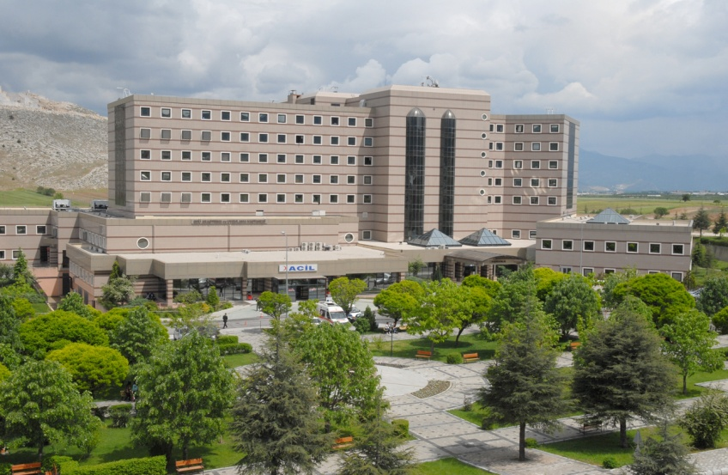
Süleyman Demirel University Research and Application Hospital
Suleyman Demirel University Research and Application Hospital, equipped with the state-of-the-art technology, continues to provide health services with the desired quality and medical expertise through its qualified staff.
Süleyman Demirel University, which started to serve on January 2, 2001, is a new hospital with the capacity of 400 beds in the Eastern Campus. SDU continues to respond to the health needs of Isparta and the surrounding region as Health Research and Application Center.
Be it physical or technological, our hospital is growing day by day and today it has reached 600 bed capacity. The hospital enjoys 33 Departments and 14 Scientific Divisions and is working with a strong academic staff that provide the highest quality healthcare service.

Slide 12
University and Social Opportunities
There are KYK state dormitories for male and female students.
SDU has more than 100 student clubs on campus.
A 24/7 service library and information center in our university. Direct internet access is available through Wifi.
There are a wide range of sports facilities, including outdoor and indoor football, basketball courts, tennis courts, indoor Olympic swimming pool, fitness rooms, indoor climbing track,
During the winter months, skiing activities are being held by Davraz Mountain ski club.
Paragliding, American football, diving, archery and many sport activities are provided to the students.
On both camps student meals and canteens meet the needs of students.

Slide 13
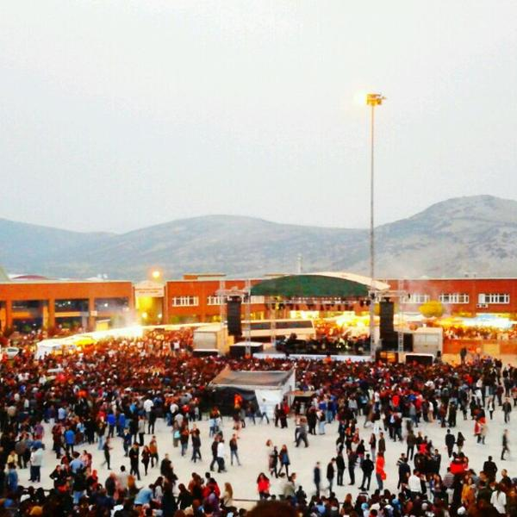
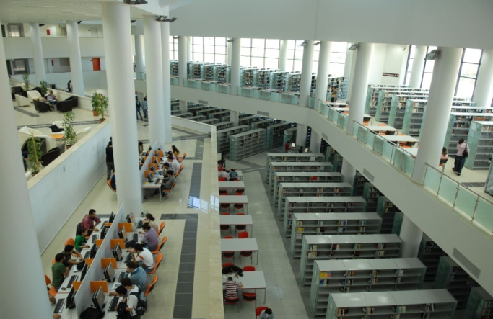
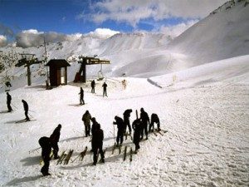
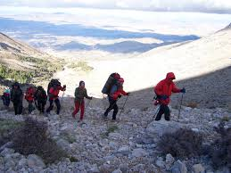
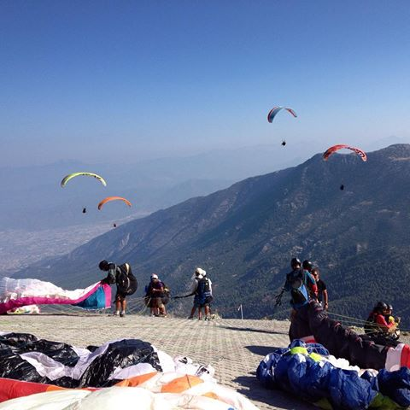
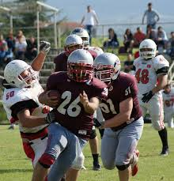
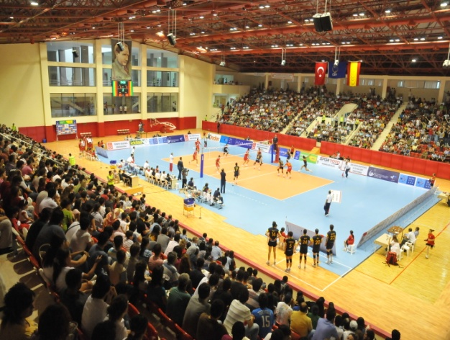

Slide 14
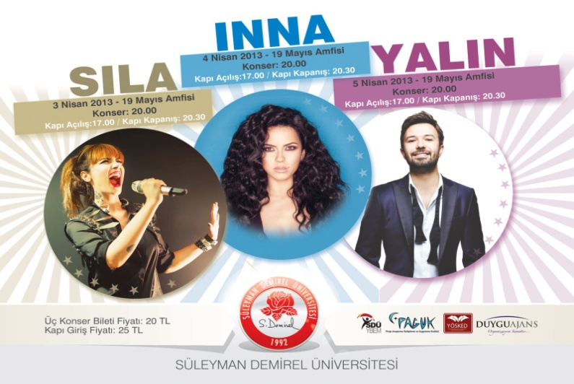
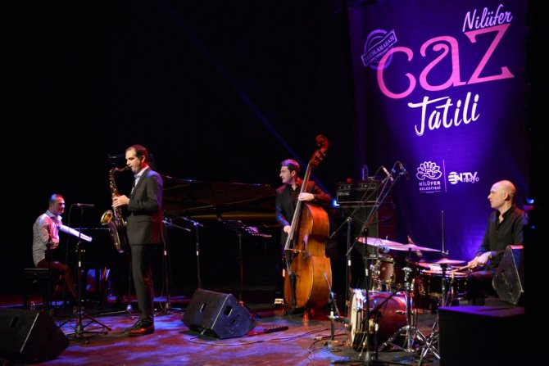
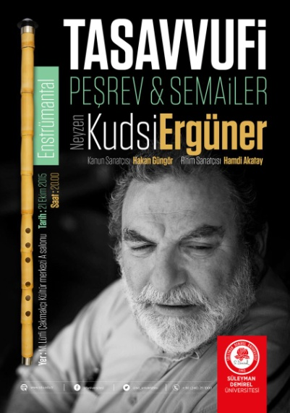
Social Activities

Slide 15
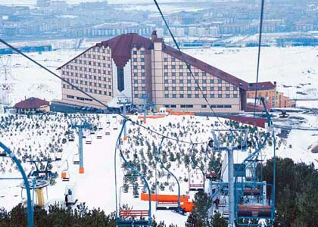
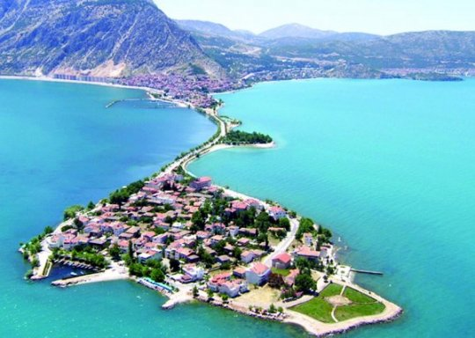
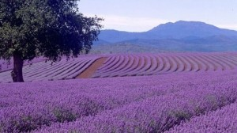
ISPARTA AND NATURAL BEAUTIES
Davraz Ski Center
It is a ski center. The sports center, which has been the center of attention for the last years in our university, attracts attention from all the surrounding regions.
Eğirdir - Isparta lays on lakes area and Eğirdir is the most important one of them. Eğirdir lies between Lake Eğirdir and the Mount Sivri, and contains a castle said to have been built by Croesus, king of Lydia, although additions were built by the Romans, Byzantines, and Seljuks.
The Lavender Gardens
The Rose Garden of Turkey have recently come to the fore with its exceptional lavender gardens, as well. The Lavanta Valley in the town of Keçiborlu, which is the most important lavender production region of our country, is one of the most beautiful and pleasant places to visit in the city.

Slide 16
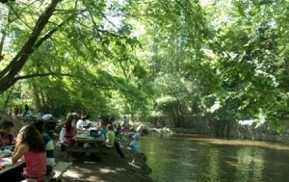
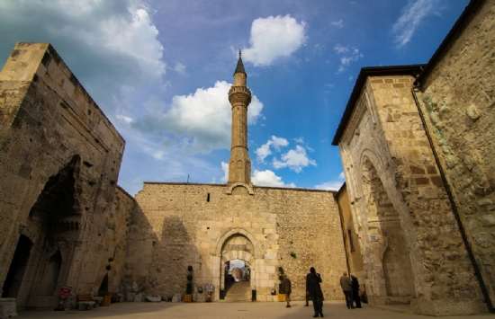
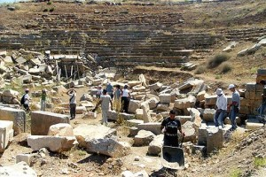
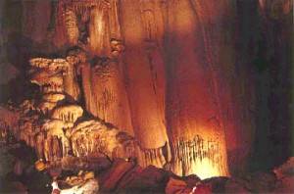
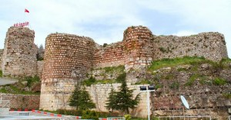
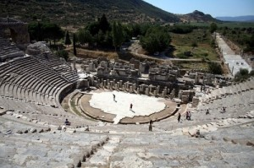

Slide 17
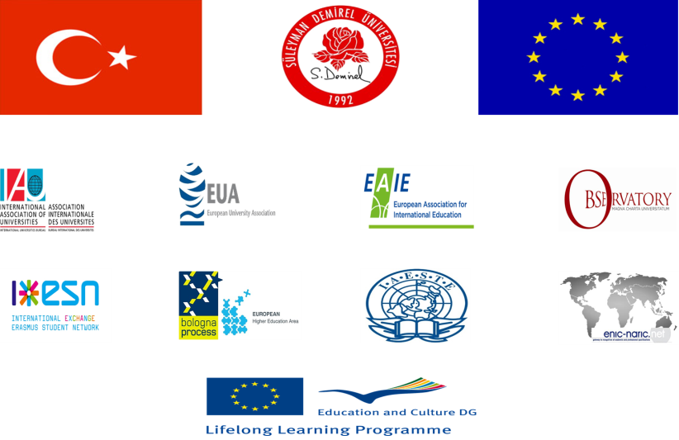
MEMBERSHIPS/AFFILIATIONS
The ENIC Network (European Network of Information Centres)
The NARIC Network (National Academic Recognition Information Centres)
Bologna Process and European Higher Education Area
The Magna Charta Universitatum
Erasmus Student Network (ESN)
European University Association (EUA)
European Association for International Education (EAIE)
The International Association of Universities (IAU)

Slide 18
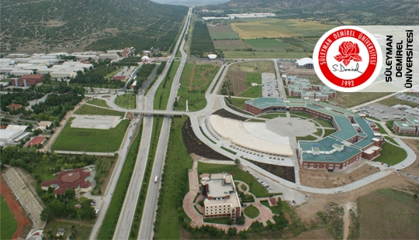
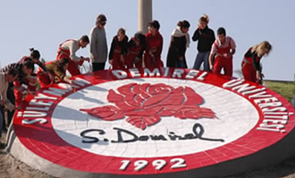
İletişim Bilgileri
DIŞ İLİŞKİLER KOORDİNATÖRLÜGÜ
Telefon: +90-246 211 8013 / 8066 / 0845
E-posta: uluslararasi@sdu.edu.tr
international@sdu.edu.tr
ERASMUS
Telefon: +90-246 211 1623
+90-246 211 8061
+90-246 211 8201 / 8202 / 8203
Faks: +90-246 211 1710
E-posta: erasmus@sdu.edu.tr
erasmusincoming@sdu.edu.tr
MEVLANA
Telefon: +90-246 211 8276 / 8277 / 8278
Faks: +90-246 211 8279
E-posta: mevlana@sdu.edu.tr
FARABİ
Telefon: +90-246 211 8093 / 8094 / 8096 Faks: +90-246 211 8292
E-posta: farabi@sdu.edu.tr
Ayrıntılı Bilgi için uluslararasi.sdu.edu.tr
adresinden bize ulaşa bilirisiniz

